Slide 1
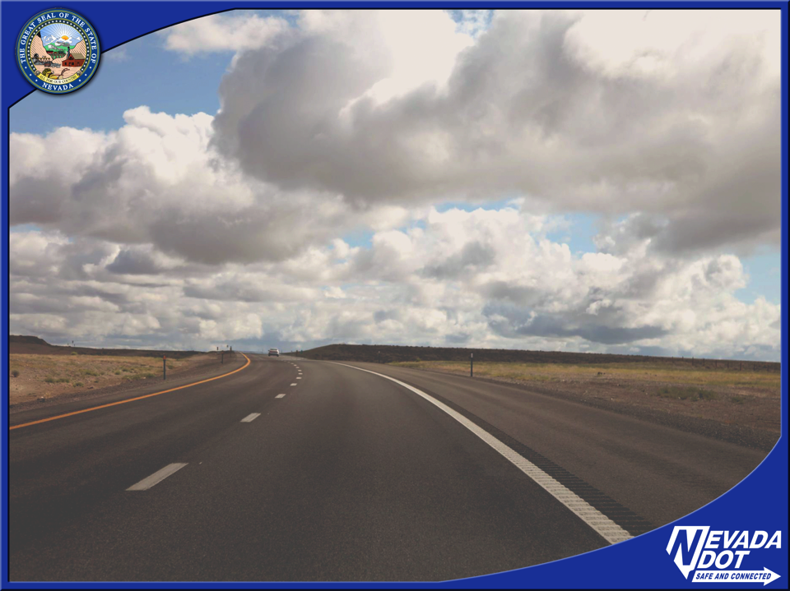

Best Broadband Solutions and Sources for Sustainable Communities
Nevada Economic Development Conference
August 20, 2018

Slide 2
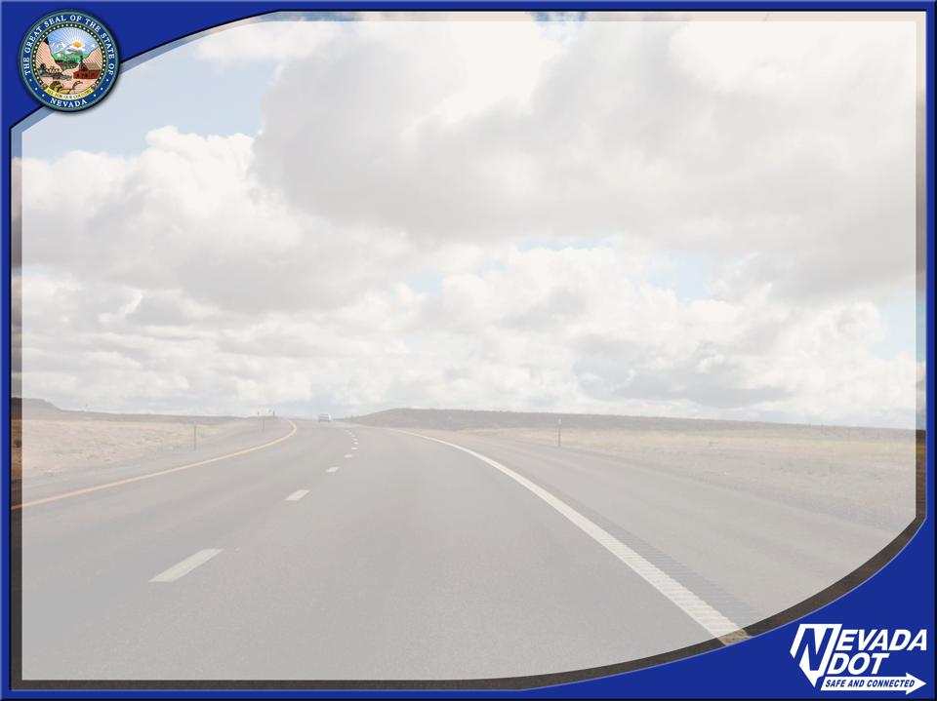
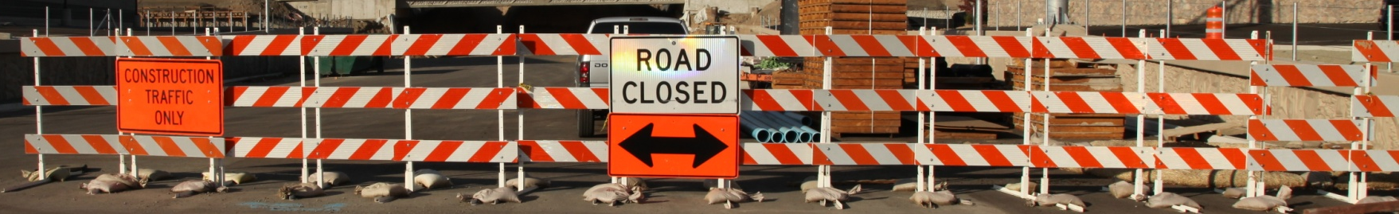
SB 53 – Telecom Infrastructure Sharing
Denise Inda
NDOT Traffic Operations

Slide 3
SB 53
Modified definitions to include fiber optics and related infrastructure
Information System
Transportation System
Highway
Notes:
During the 2017 Legislative session, the passage of SB 53 provided NDOT greater latitude to enter into public private partnerships of telecommunication transportation facilities when it serves a public purpose.
The definitions of information system, transportation system, and highway were modified to included fiber optics, wire, and related infrastructure for conveying telecommunications equipment.

Slide 4
NDOT AUTHORITY
Grant longitudinal access for use of conduit, facilities and wireless access for fair compensation
Develop regulations and policies
Enter into an agreement
Issue an encroachment permit
Notes:
SB 53 enables NDOT to partner with the telecom industry to grant access for the use of conduit and related facilities for compensation.
In order to meet the obligations laid out in the legislation, NDOT must
Develop regulations and policies governing this initiative
Coordinate with OSIT, telecom providers and other interested parties
Place additional conduit and related facilities within the right of way for use by telecom providers
Enter into an agreement and issue an encroachment permit to the telecom provider for infrastructure installation within the right of way

Slide 5
CONTENT OF AGREEMENT
Terms of renegotiation
Terms of maintenance
Term of 30 years or less
Does not grant a property interest in a r/w
Fair, reasonable, competitively neutral, and nondiscriminatory compensation
Notes:
SB 53 spells out several components of the agreement. We have been working with the Director’s office, the governor’s office, Right of Way and Legal divisions and have developed a draft master agreement and site specific agreement for use with interested parties.

Slide 6
COMPENSATION
Based on a fair-trade value
Cash or in-kind compensation
Monetary compensation placed in the Highway fund
In-kind compensation used for statewide telecommunications purposes
Notes:
In order to ensure fair and adequate compensation for the use of the right of way and infrastructure,
NDOT must develop a process and structure for shared or traded infrastructure.

Slide 7
SB 53 PROGRESS
Interstate & Non-Interstate Routes
Non-interstate Policy
Interstate Regulations
Master Agreement
Location Specific Agreement
Telecom Infrastructure
Request Form
Notes:
NDOT developed a policy for non-interstate trades based on SB 53 and we’ve submitted the corresponding regulation for interstate routes. We will continue moving our way through the regulation setting process once the draft regs come back from LCB.
We developed a shell for a Master agreement between NDOT and telecom companies that establishes the roles and responsibilities for each party.
As well as a location specific agreement shell that will incorporate the trade value.
In addition, each location will have an associated encroachment permit.
We are developing a form to be used to request telecom infrastructure.
We shared this information with telecoms in March of this year to make them aware of this new opportunity.

Slide 8
BEST PRACTICES
Bi-annual planning meetings with providers and state & local agencies
Establish single POC to simplify inquiries
Establish valuation process with 5 yr updates
Maximize effectiveness of trades
Keep trade balance sheet
Notes:
We are looking at a variety of best practices to include in Nevada’s program, based on our statutes and what works best for our state.
Host annual planning meetings to overlay state projects with the needs and priorities of providers and other agencies.
Establish a single point of contact with NDOT and OSIT for the state to make it easier to manage inquiries. This could include permit and ROW office coordination, IRU contracts, provider contacts, and city and county master plans.
Establish ongoing GIS mapping of fiber lines and fiber assets.
Do trade agreements other than fee based charges. Much more effective. Trade existing or planned conduit and fiber on a foot-by-foot basis and trade fiber optic on a foot-by-foot strand basis.
Keep values on a balance sheet and review annually. Make it possible for providers to “bank” their credits to save for really large projects.
Prioritize projects suitable for additional construction based on a scoring mechanism.
Develop a refined estimate of the incremental costs during the design phase
Develop a standard engineering specification for dig-once conduit
Develop a procedure to systematically track and manage construction projects

Slide 9
BENEFITS
Expands infrastructure statewide
Reaches underserved and unserved areas
Attracts fiber telecom providers to cities and counties
Reduces costs through coordinated construction efforts
Notes:
There are many advantages to a fiber trade and dig once policy.
Deployment time is reduced through easier right of way access and no exclusive access by any one provider, cooperation amongst state and federal agencies.
Infrastructure is expanded throughout entire state and into underserved and unserved areas
Cities and counties can more easily attract fiber telecom providers
Protects newly and recently paved roads and sidewalks, enhancing the uniformity of construction
Ensure efficient, non-duplicative placement of infrastructure in the ROW
Overall cost of all underground work in the ROW is reducers for both public and private parties, including utilities, telecoms, and agencies
Construction costs are minimized through the coordinated construction efforts and economy of scale

Slide 10
UDOT IMPLEMENTATION
Notes:
NDOT based our program off of the success of the 20+ year old program in Utah, which started when UDOT was preparing for the 2002 Winter Olympics and began installing fiber in key areas to provide traffic management capabilities necessary for the Olympics-related traffic.
This graph shows UDOT system expansion over a 15 year period, beginning in 2001.
The red bars show the miles of UDOT infrastructure, and the pink bars show the miles of traded infrastructure.
By 2015, there were approximately 2,500 miles of infrastructure installed with nearly $75 million dollars worth of trade.
The partnership between the providers and the public agencies in Utah has been used to all the players’ benefit.

Slide 11
RETURN ON INVESMENT
Notes:
This graph shows the system expansion between 2011 and 2015
There were 18 trades completed for 812 miles of fiber, conduit and circuit for a value close to $29 million dollars.

Slide 12
PARTNERING OPPORTUNITIES
US 50 Fiber Hut – Ely
SR 439 Spare Conduit
I 80 to US 50 Connectivity
Other Locations
Notes:
There are equally as exciting opportunities in Nevada.
An example of benefits in Nevada are as follows:
NDOT is wrapping up a fiber hut installation project on US 50 that enables state agency access to existing fiber in the corridor. NDOT is in discussions with a telecom company looking to expand their system in the vicinity of Ely. Initial discussions have identified NDOT infrastructure (tower, rack space, etc.) that would be of value to the telecom provider and the process to share and trade infrastructure under SB 53 has begun. This partnership will enable the telecom provider to minimize their expansion costs in this rural area while allowing NDOT to evaluate areas where shared infrastructure or a joint build might provide a benefit to the state.
I’ll provide more detail on SR 439 and the I 80 to US 50 connection on the next slide.
We are also discussing opportunities for shared infrastructure in other locations where there is mutual benefit.

Slide 13
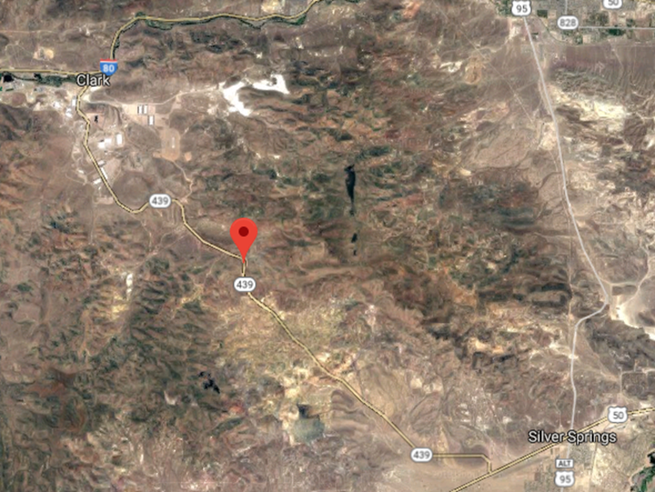
SR 439 USA PARKWAY
Old Section
New Section
Notes:
In the meantime, we’re working with various parties on partnering opportunities. Because we installed spare conduit on the new portion of SR 439 (USA Parkway) we have been working with multiple companies on the use of those conduits.
While you may not be able to see this in great detail, here is a map of SR 439. I’ve pointed out the 19 miles of new construction where NDOT has spare conduit, as well as the original section, closer to I 80, where we would like to expand our infrastructure. It is NDOT’s desire to connect fiber between US 50 and I 80, and we have identified opportunities for joint builds within the older portion of SR 439 to extend NDOT’s conduit infrastructure.
We are working with other parties to identify opportunities for infrastructure sharing that will meet their needs an expand the NDOT system, and our efforts are in various stages at this point.

Slide 14
White Pine Dig Once and Trade Agreement
NDOT Beautification Project starts spring of 2019
$30 million investment
12 mile project; Hwy. 50, Hwy. 6
Work with providers to sign trade agreement, enter trench, bring in fiber

Slide 15

Contact Info:
Denise M. Inda, PE, PTOE
Chief Traffic Operations Engineer
Nevada Dept. of Transportation
775-888-7080
dinda@dot.nv.gov
Jojo Myers Campos
State Broadband Development Manager
Governor’s Office of Science, Innovation & Technology
775-687-0993
jmyers@gov.nv.gov

Slide 16



